Slide 1

FRAILTY, you said FRAILTY ? What is it ?
Donata Kurpas
Jose Augusto Simoes
Jean-Baptiste Kern
Jean-Pierre Jacquet

Slide 2
Frailty, is a disturbing term for GPs, because it doesn't cover a disease or an illness even a syndrome, but this term try to define patients with clinical ,social and environmental situation at risk of dependency but not only.
It's probably why different ways exists.
and it is what we will explore during this workshop.

Slide 3
For this purpose we will present to you a short description of a research project in progress "MyLittleSpa" and the huge experience of Pr Donata Kurpas.
Thus we will share our experiences and informatin to take home to help our ourselves, our patients and the community
Notes:
Please present yourself and tell your experiences and expectations about frailty

Slide 4
MLSPA is a co-designed system focusing on the rural European elderly and frailty population. The project aims to develop a remote connected device with an interactive vocal personal assistant that provides a panel of social/medical services for frailty population in Portugal and in France. The global objective is to create a new solution improving their life quality, their self-autonomy and their integration with the surrounding community.

Slide 5
Interventions in Frailty – WMU,Poland
(ClinicalTrials NCT03194412)
Donata Kurpas, Maria Magdalena Bujnowska-Fedak, Aneta Soll, Katarzyna Szwamel
Wroclaw Medical University, Poland

Slide 6
Interventions WMU
Study Starts: May 19, 2017 - SYMPOSIUM
Study Completion: December 2017
Primary Completion: September 2017
Screening Evaluation (stage 1) - investigated within 0
Baseline Evaluation (stage 2) - after 3 months from 0
Final Evaluation (stage 3) - after 6 months from 0

Slide 7
Inclusion criteria
Patient:
  age ≥ 60 years old
  recognition of the pre-frail and frail (based on the scale of the Cardiovascular Health Study)
  consent to participate in the study
  patients who can speak the Polish language
Caregivers:
  formal or informal caregivers of person aged ≥ 60 years old
  consent to participate in the study
  caregivers who can speak the Polish language

Slide 8
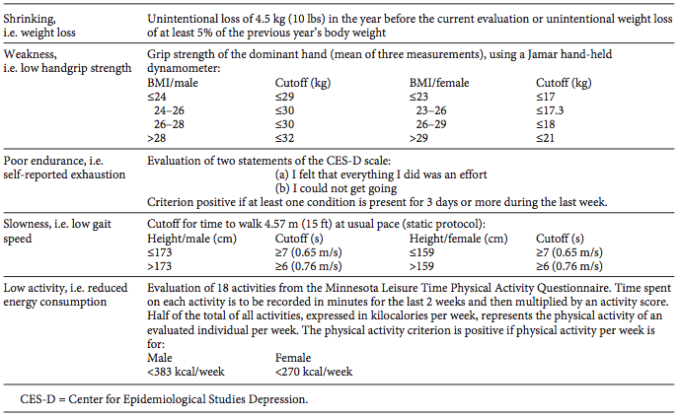

Slide 9
Methods
Method:
  diagnostic survey
Technique:
  the 'surveys combined with direct measurements of patients investigated within 0, after 3 and 6 months

Slide 10
Methods - Tools
Standardized questionnaires:
  Center for Epidemiologic Studies Depression Scale
  Minnesota Leisure Time Physical Activity Questionnaire
  Vulnerable Elders — 13 Survey
  Mini Nutritional Assessment
  Health Behaviour Inventory
  Montreal Cognitive Assessment
  Geriatric Depression Scale
  World Health Organization Quality of Life (short version) questionnaire
  Camberwell Assessment of Need Short Appraisal Schedule
  Barthel Scale
  Activities of Daily Living
  Instrumental Activities of Daily Living
  Timed up and go test
  Beck Depression Inventory

Slide 11
Methods - Tools
The questionnaire on: socio-demographic data - age, gender, marital status, living in relationship/ without relationship, level of education, place of residence, economic status; the number of hospitalizations in the last 3 years (including kind of ward); the number and kind of chronic diseases (ICD-10); the number of permanent medications; employment situation; number of traveling in the last year; having pets; number of languages the participants can speak; number of falls
Rating of patients' difficulties in the implementation of the intervention (Did the patients perform the interventions? How often? Was it difficult to the patients?)
Observations sheet: height, weight, BMI, hand grip strength, circumference of arm muscle, circumference of calf
The available results of laboratory tests: sodium , albumins, lymphocytes, LDL cholesterol, C reactive proteins, glomerular filtration rate, fasting glucose, thyroid hormones, etc.

Slide 12
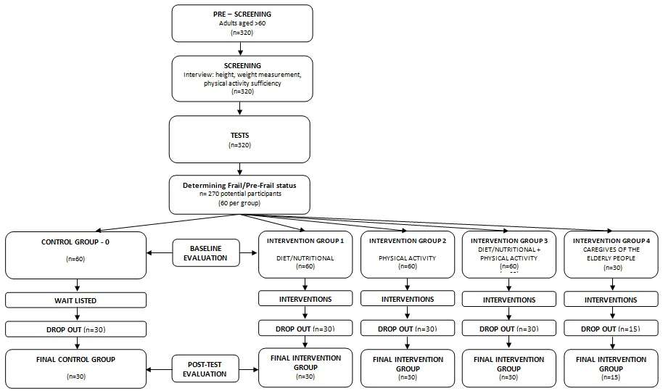

Slide 13
Group 1. Diet /nutritional
Each patient collect a detailed menu of the last two days before making the description.
Menu is analyzed by a nutrition consultant. The role of nutrition consultant is:
to make a diet modification and include the products recommended in frailty
focus on eating habits
3. The diet modification is mainly focused on adequate supply:
protein according to European Society for Clinical Nutrition and Metabolism (ESPEN recommendations)
vitamin D (according to Central Europe guidelines -2013 for seniors)

Slide 14
Group 2. Physical activity
1. Frequency: twice a week x 60 minutes
2. Worksheets for the elderly with frailty syndrome have been developed:
resistance exercises and strength training, with the purpose to improve muscle strength in the limbs
exercises designed to improve motor coordination, flexibility and speed
stretching exercises
3. The program has been developed by a physiotherapist
workouts are held twice a week for 60 minutes and are conducted by volunteers trained by the author of the exercises
patients receive a set of exercises and should practice at home:
written exercises were prepared for patients (type of exercise, detailed description of performance, number of repetitions)
instructional video on DVD and available online

Slide 15
Group 3. Comprehensive therapy
Special diet for elderly
(as in group 1)
Regular physical activity in everyday life of the elderly (as in group 2)
Comprehensive therapy
1. Duration:
the first stage - 3 months: 12 weeks
the second stage - 3 months: 12 weeks
2. Frequency of physical activity: twice a week x 60 minutes

Slide 16
Group 4. Caregivers of elderly
1. Group: formal and informal caregivers of elderly with frailty syndrome
2. Education about frailty: prevention and treatment (nutrition, physical activity, dietary supplement diet)
2. Materials and Tools: multimedia presentation about frailty prevention and treatment (nutrition, physical activity, dietary supplement diet)
3. Duration:
the first stage - 3 months: 12 weeks
the second stage - 3 months: 12 weeks
4. Frequency: 1 (at the beginning of stage 0, 1 and 2) x 60 minutes

Slide 17

Group 5. Control group
group
without
any intervention

Slide 18
Our groups - currently
Group | Description | n
1 | Diet /nutritional | 40
2 | Physical activity | 42 D&A 34 M
3 | Comprehensive therapy | 45
4 | Caregivers of elderly | 23
5 | Control group | 63
Total |  | 247

Slide 19
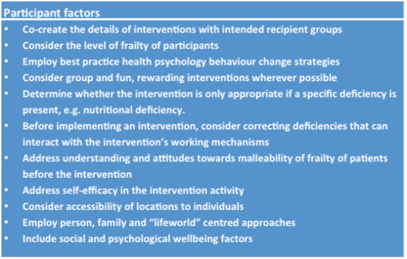
Guidelines

Slide 20
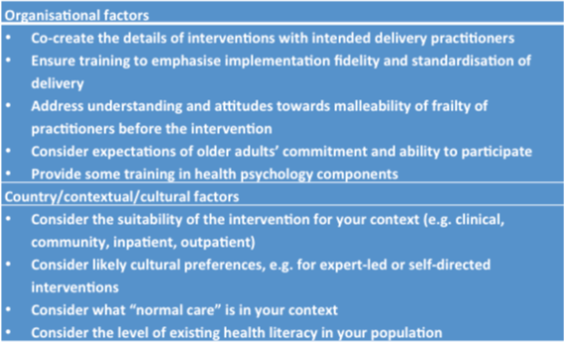
Guidelines

Slide 21
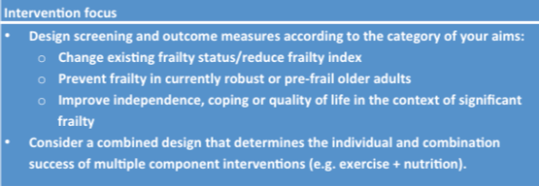
Guidelines

Slide 22
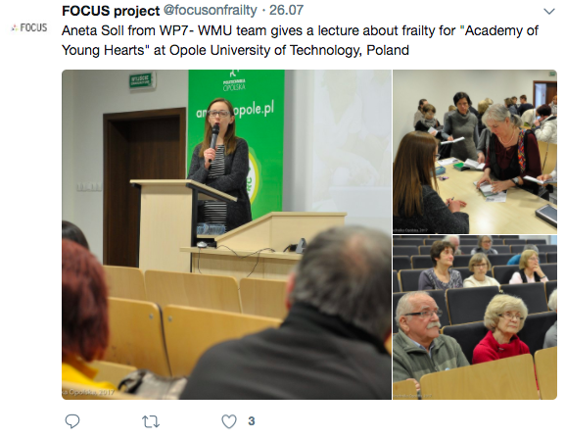

Slide 23
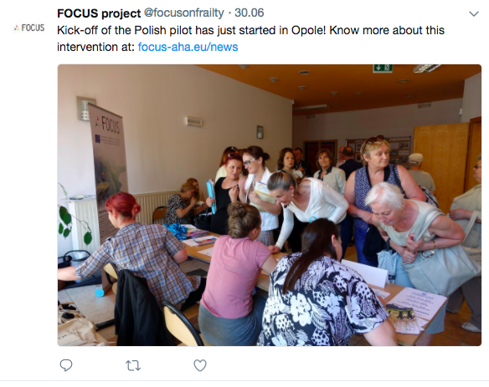

Slide 24
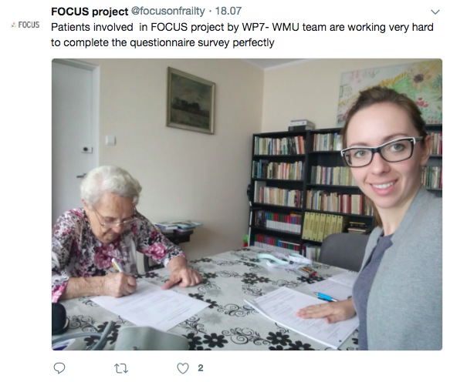

Slide 25
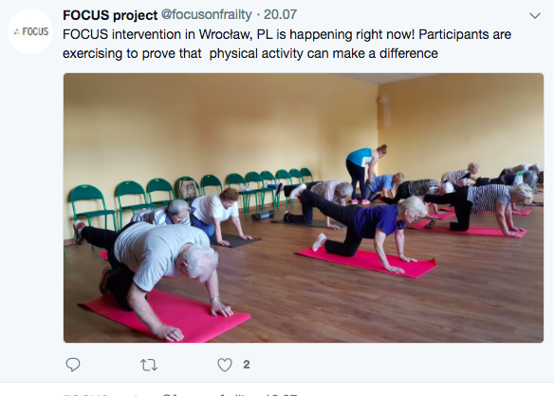

Slide 26
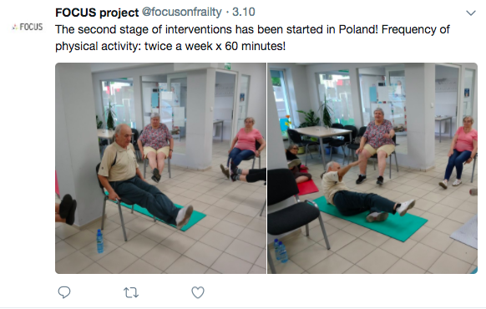

Slide 27
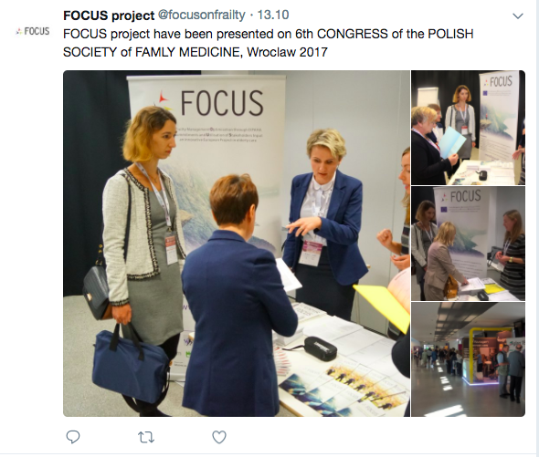

Slide 28
Patients – WMU pilot

Slide 29
Gender and Age
GROUP | GENDER |  | AGE
 | Women (n=157) | Men (n=54) | mean | SD
G1 diet | 30 (75.0%) | 10 (25.0%) | 69.87 | 6.17
G2 physical activity | 26 (61.9%) | 16 (38.1%) | 69.38 | 6.66
G3 (G1+G2) | 36 (80.0%) | 9 (20.0%) | 70.80 | 6.09
G4 caregivers | 19 (82.6%) | 4 (17.4%) | 57.74 | 14.02
G5 control | 46 (75.4%) | 15 (24.6%) | 79.13 | 9.04

Slide 30
Level of education
 | Low (primary, junior high school) | Medium (secondary or post-secondary) | High (higher)
G1 diet | 12 (30.0%) | 21 (52.5%) | 7 (17.5%)
G2 physical activity | 18 (42.9%) | 16 (38.1%) | 8 (19.0%)
G3 (G1+G2) | 16 (35.6%) | 18 (40.0%) | 11 (24.4%)
G4 caregivers | - | 13 (59.1%) | 9 (40.9%)
G5 control | 32 (53.3%) | 23 (38.3%) | 5 (8.3%)

Slide 31
Martial status
 | single | married | widow /widower | divorced
G1 diet | 3 (7.5%) | 26 (65.0%) | 11 (27.5%) | -
G2 physical activity | 3 (7.1%) | 29 (69.0%) | 9 (21.4%) | 1 (2.4%)
G3 (G1+G2) | 3 (6.7%) | 27 (60.0%) | 14 (31.1) | 1 (2.2%)
G4 caregivers | 3 (13.0%) | 16 (69.6%) | 2 (8.7%) | 2 (8.7%)
G5 control | 6 (9.8%) | 16 (26.2%) | 36 (59.0%) | 3 (4.9%)

Slide 32
Place of residence
 | big city | average city | small city | village
G1 diet | 4 (10.3%) | 15 (38.5%) | 1 (2.6%) | 19 (48.7%)
G2 physical activity | 4 (9.5%) | 12 (28.6%) | 6 (14.3%) | 20 (47.6%)
G3 (G1+G2) | 13 (30.2%) | 7 (16.3%) | 3 (7.0%) | 20 (46.5%)
G4 caregivers | - | 16 (69.6%) | 6 (26.1%) | 1 (4.3%)
G5 control | 10 (17.2%) | 13 (22.4%) | - | 35 (60.3%)

Slide 33
Right hand grip strenght (kg)
Group | T0 | T1 | T2 | p
 | Mean/SD (N)
G1 diet | 19.51/8.62 (40) | 19.71/7.9 (34) | 21.05/6.54 (23) | 0.271
G2 physical activity | 17.80/6.15 (42) | 17.94/5.86 (35) | 20.08/4.70 (26) | 0.216
G3 (G1+G2) | 16.45/6.26 (45) | 17.02/4.33 (33) | 16.95/3.57 (31) | 0.188
G5 control | 14.53/7.56 (61) | 12.45/6.08 (61) | 14.07/5.64 (38) | 0.238

Slide 34
Left hand grip strenght (kg)
Group | T0 | T1 | T2 | p
 | Mean/SD (N)
G1 diet | 18.53/7.89 (40) | 17.53/6.07 (35) | 18.56/6.07 (23) | 0.632
G2 physical activity | 17.99/6.05 (6.15) | 16.67/4.26 (35) | 17.82/3.94 (26) | 0.445
G3 (G1+G2) | 14.66/5.88 (45) | 14.52/3.70 (33) | 14.77/3.56 (31) | 0.941
G5 control | 14.45/7.58 (61) | 10.94/5.69 (61) | 12.71/4.40 (38) | 0.029

Slide 35
CES-D Center for Epidemiologic Studies Depression Scale
Group | T0 | T1 | T2 | p
 | Mean/SD (N)
G1 diet | 17.29/8.20 (28) | 18.26/8.07 (27) | 18.79/7.06 (19) | 0.528
G2 physical activity | 17.53/7.93 (38) | 17.27/6.88 (33) | 16.83/4.67 (24) | 0.938
G3 (G1+G2) | 20.11/6.94 (35) | 17.19/6.65 (27) | 20.07/5.84 (28) | 0.215
G5 control | 20.88/8.42 (52) | 23.35/9.27 (51) | 19.90/5.42 (30) | 0.192

Slide 36
MOCA - Montreal Cognitive Assessment
Group | T0 | T1 | T2 | p
 | Mean/SD (N)
G1 diet | 23.34/3.81 (38) | 24.28/4.02 (32) | 24.68/2.42 (22) | 0.254
G2 physical activity | 23.67/3.48 (42) | 23.88/4.30 (35) | 26.23/2.75 (26) | 0.005
G3 (G1+G2) | 22.20/4.35 (45) | 23.64/3.64 (33) | 24.09/2.67 (32) | 0.167
G5 control | 16.25/5.97 (61) | 17.36/6.89 (61) | 20.54/5.91 (37) | 0.006

Slide 37
GDS - Geriatric Depression Scale
Group | T0 | T1 | T2 | p
 | Mean/SD (N)
G1 diet | 7.88/6.03 (40) | 7.81/6.63 (36) | 7.65/5.37 (23) | 0.965
G2 physical activity | 9.19/6.39 (42) | 6.83/5.12 (35) | 5.96/5.70 (26) | 0.041
G3 (G1+G2) | 12.42/7.02 (45) | 9.79/7.30 (33) | 9.44/5.72 (32) | 0.120
G5 control | 14.52/7.25 (61) | 13.77/6.76 (62) | 11.20/6.05 (40) | 0.061

Slide 38
TUG - Timed up and go test (seconds)
Group | T0 | T1 | T2 | p
 | Mean/SD (N)
G1 diet | 8.51/2.60 (9) | 10.75/5.25 (35) | 9.84/2.59 (23) | 0.223
G2 physical activity | 11.90/3.07 (13) | 10.55/4.17 (34) | 10.84/3.16 (26) | 0.283
G3 (G1+G2) | 11.52/3.63 (20) | 10.69/3.71 (32) | 9.38/3.67 (32) | 0.001
G5 control | 15.60/9.44 (25) | 16.31/11.52 (50) | 16.79/9.40 (32) | 0.728

Slide 39
Pro-healthy behaviours (sum)
Group | T0 | T1 | T2 | p
 | Mean/SD (N)
G1 diet | 91.34/12.8 (35) | 92.33/7.6 (27) | 91.73/5.96 (15) | 0.970
G3 (G1+G2) | 86.78/9.99(41) | 95.30/5.65 (20) | 95.72/7.93(18) | 0.001
G4 | 86.14/13.4(22) | 87.27/15.3 (15) | 97.0/NA (1) | 0.642
G5 control | 87.29/14.5 (52) | 88.84/12.9(49) | 90.10/13.5(21) | 0.743

Slide 40
CANSAS (Camberwell index)
Group | T0 | T1 | T2 | p
 | Mean/SD (N)
G1 diet | 0.86/0.14 (40) | 0.85/0.14 (36) | 0.90/0.09 (23) | 0.525
G2 physical activity | 0.84/0.13 (42) | 0.89/0.10 (34) | 0.90/0.09 (26) | 0.138
G3 (G1+G2) | 0.80/0.15 (45) | 0.87/0.11 (32) | 0.85/0.14 (32) | 0.143
G4 | 0.85/0.10 (23) | 0.87/0.10 (18) | 0.97/0.04 (2) | 0.063
G5 control | 0.67/0.19 (60) | 0.70/0.19 (60) | 0.78/0.17 (38) | 0.020

Slide 41
QoL Physical domain
Group | T0 | T1 | T2 | p
 | Mean/SD (N)
G1 diet | 13.19/3.15 (40) | 13.24/2.59 (36) | 13.86/1.63 (23) | 0.616
G2 physical activity | 13.58/2.63 (42) | 13.99/1.77 (35) | 14.53/1.78 (26) | 0.201
G3 (G1+G2) | 12.84/2.60 (45) | 13.59/2.32 (33) | 13.66/2.76 (32) | 0.101
G4 | 14.41/2.86 (23) | 15.02/2.27 (18) | 15.71/2.83 (2) | 0.725
G5 control | 10.64/3.48 (61) | 11.69/2.83 (62) | 12.01/2.62 (40) | 0.046

Slide 42
QoL Psychological domain
Group | T0 | T1 | T2 | p
 | Mean/SD (N)
G1 diet | 14.52/2.25 (40) | 14.94/1.68 (36) | 15.04/1.38 (23) | 0.339
G2 physical activity | 14.44/2.53 (42) | 14.99/1.73 (35) | 15.56/1.15 (26) | 0.116
G3 (G1+G2) | 13.57/2.37 (45) | 14.24/2.65 (33) | 14.44/1.93 (32) | 0.097
G4 | 14.96/2.78 (23) | 15.48/1.76 (18) | 14.33/1.41 (2) | 0.640
G5 control | 11.91/3.21 (61) | 12.73/2.92 (62) | 13.78/2.86 (40) | 0.001

Slide 43
QoL Sociological domain
Group | T0 | T1 | T2 | p
 | Mean/SD (N)
G1 diet | 13.13/3.48 (40) | 13.78/3.31 (36) | 13.97/3.64 (23) | 0.215
G2 physical activity | 13.90/2.62 (42) | 14.59/2.38 (35) | 14.21/3.37 (26) | 0.449
G3 (G1+G2) | 12.98/2.61 (45) | 13.37/3.54 (33) | 13.88/4.01 (32) | 0.143
G4 | 14.20/2.77 (23) | 14.37/2.61 (18) | 14.00/4.71 (2) | 0.985
G5 control | 12.37/3.51 (61) | 11.91/4.10 (62) | 11.50/3.43 (40) | 0.582

Slide 44
QoL Environmental domain
Group | T0 | T1 | T2 | p
 | Mean/SD (N)
G1 diet | 14.01/2.86 (40) | 14.35/2.31 (36) | 15.74/0.81 (23) | 0.005
G2 physical activity | 14.83/2.47 (42) | 15.16/1.88 (35) | 15.38/1.82 (26) | 0.425
G3 (G1+G2) | 14.50/2.25 (45) | 14.02/3.23 (33) | 14.88/2.75 (32) | 0.207
G4 | 14.46/2.39 (23) | 15.08/1.67 (18) | 13.50/0.71 (2) | 0.344
G5 control | 12.90/3.17 (61) | 12.78/3.60 (62) | 13.50/3.82 (40) | 0.036

Slide 45
ADL - Activities of Daily Living
Group | T0 | T1 | T2 | p
 | Mean/SD (N)
G1 diet | 5.70/0.72 (40) | 5.42/1.68 (36) | 5.87/0.46 (23) | 0.524
G2 physical activity | 5.74/0.86 (42) | 5.60/1.42 (35) | 5.54/1.63 (26) | 0.790
G3 (G1+G2) | 5.76/1.00 (45) | 5.33/1.74 (33) | 5.69/1.12 (32) | 0.287
G4 | - | - | - | -
G5 control | 4.74/1.74 (61) | 4.45/2.00 (62) | 4.45/2.16 (4) | 0.893

Slide 46
IADL - Instrumental Activities of Daily Living
Group | T0 | T1 | T2 | p
 | Mean/SD (N)
G1 diet | 24.77/4.02 (39) | 25.29/3.10 (35) | 25.48/2.02 (23) | 0.798
G2 physical activity | 25.27/2.03 (40) | 25.38/3.18 (34) | 25.96/1.07 (23) | 0.497
G3 (G1+G2) | 25.14/2.54 (43) | 25.52/1.43 (29) | 26.00/2.76 (31) | 0.013
G4 | - | - | - | -
G5 control | 19.24/6.49 (59) | 20.19/6.57 (57) | 21.37/5.46 (35) | 0.256

Slide 47
Beck Depression Inventory
Group | T0 | T1 | T2 | p
 | Mean/SD (N)
G1 diet | - | - | - | -
G2 physical activity | - | - | - | -
G3 (G1+G2) | - | - | - | -
G4 | 9.05/11.19 (19) | 8.67/9.04 (15) | 6.00/7.07 (2) | 0.979
G5 control | - | - | - | -

Slide 48
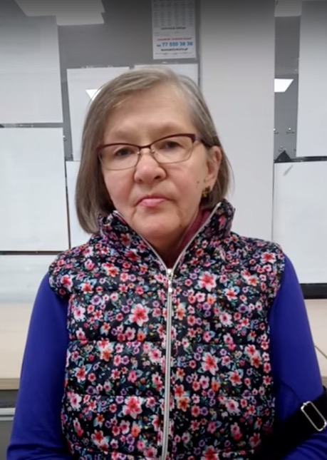

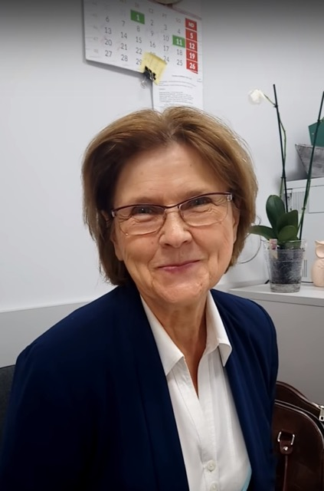
Seniors about the interventions

Slide 49
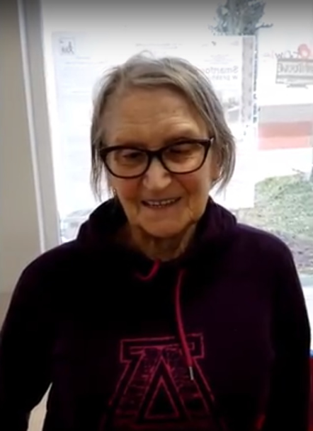
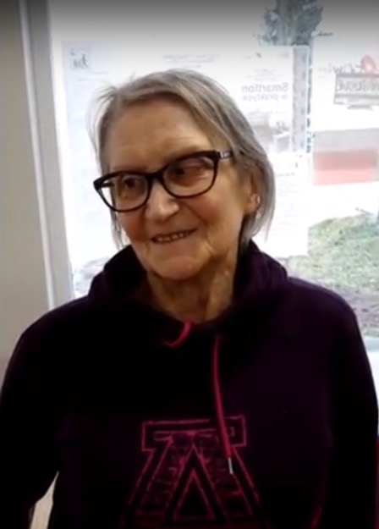

Seniors about the PKE

Slide 50
The biggest difficulties for patients:
a lack of motivation for exercises
regularity of exercises
preparing meals according to recommendations
choosing and buying the right nutritional products

Slide 51
Reasons for reducing groups:
large volume of questionnaires
getting sick (autumn-winter period)
control group - a lack of motivation to meet - no intervention
shortage of personnel carrying out the interventions

Slide 52

The Info Movie for the Patients

Slide 53
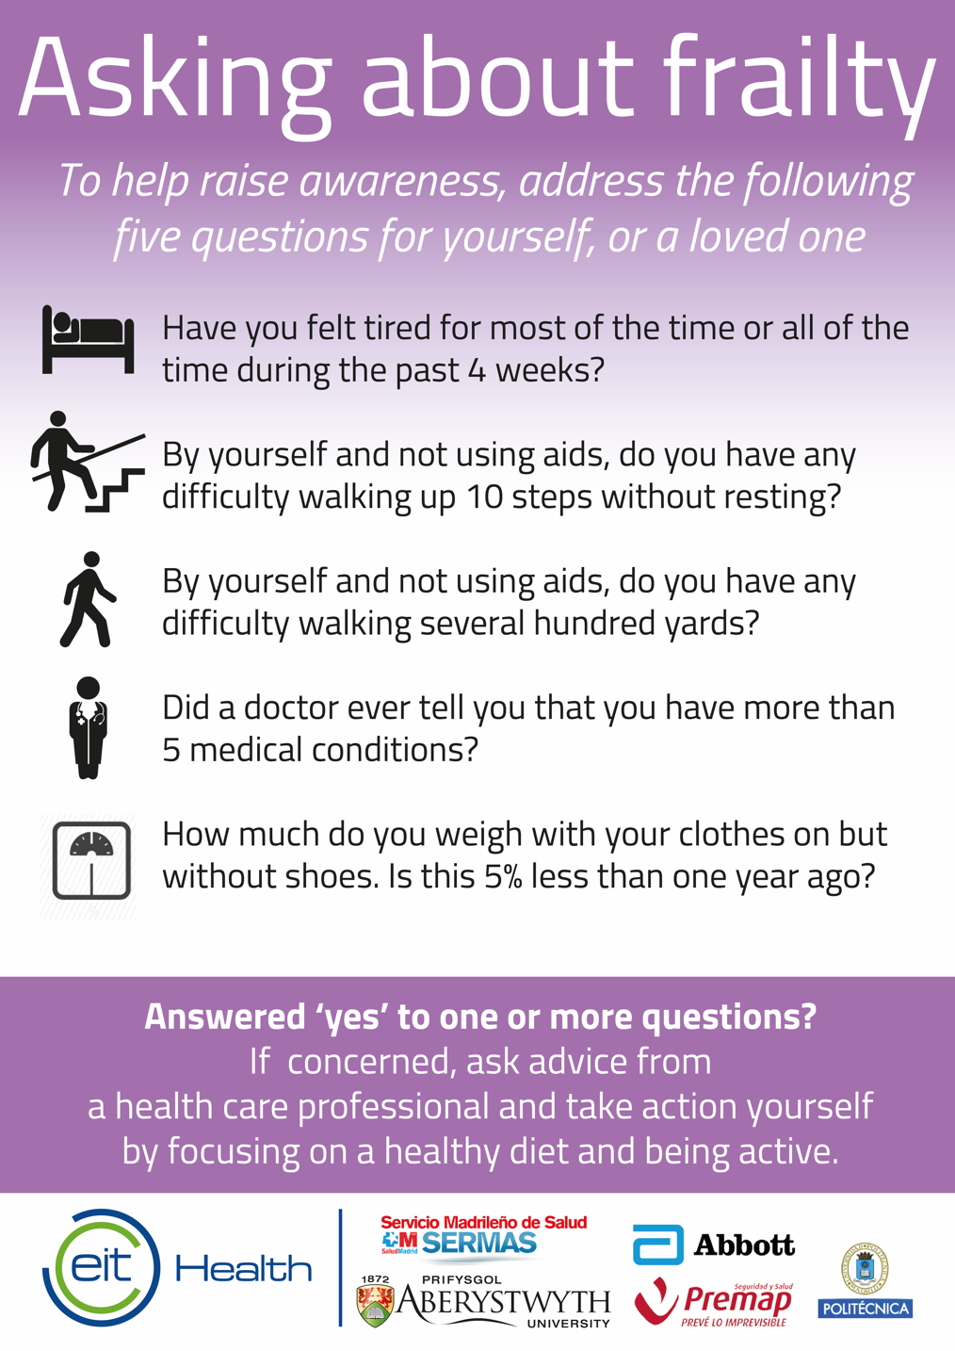
Frailty scale
More:
Notes:
Frailty is a clinical state in which there is an increase in an individual’s vulnerability for
developing increased dependency and/or mortality when exposed to a stressor. Frailty can occur as
the result of a range of diseases and medical conditions.

Slide 54
The Short Physical Performance Battery
(SPPB)
three parts:
  balance (three positions)
  slowness
  stand up and sit down in a chair five times
The final score results from the sum of the three sub-test, and ranges from 0 (worst) to 12. A total score below 10 indicates frailty, high risk of disability and falls
Notes:
three parts:
balance (three positions: feet together, semitandem and tandem),
slowness (time that patient spends to walk 4 meters, at normal pace)
stand up and sit down in a chair five times. It is very important to do the test in the correct order, because if we start with the stand up one, the patient can be fatigued and offer some incorrect results in the other two sub-test (balance and slowness).
The final score results from the sum of the three sub-test, and ranges from 0 (worst) to 12. A total score below 10 indicates frailty, high risk of disability and falls

Slide 55
Linda Fried Criteria (Frailty Phenotype model)
Weight loss
Weakness
Poor endurance and energy
Slowness
Low physical activity level
Fried’s Model scores range from 0–5 (i.e., 1 point for each component; 0=best to 5=worst) and represent frail (3–5), pre-frail (1–2), and robust (0) health status
Notes:
Weight loss: we ask the patient about unintentional weight loss, of 4.5 kilograms in prior year or, at follow-up, of 5% of body weight in prior year (by direct measurement of weight).
Weakness: grip strength in the lowest 20% at baseline, adjusted for gender and body mass index.
Poor endurance and energy: as indicated by self-report of exhaustion. Self-reported exhaustion, identified by two questions from the CES–D scale, is associated with the stage of exercise reached in graded exercise testing, as an indicator of VO2 max, and is predictive of cardiovascular disease.
Slowness: The slowest 20% of the population was defined at baseline, based on time to walk 4.5 meters, at normal pace, adjusting for gender and standing height.
Low physical activity level: A weighted score of kilocalories expended per week was calculated at baseline, based on each participant’s report. The lowest quintile of physical activity was identified for each gender.
Fried’s Model scores range from 0–5 (i.e., 1 point for each component; 0=best to 5=worst) and represent frail (3–5), pre-frail (1–2), and robust (0) health status

Slide 56
The Frailty Trait scale
Energy balance and nutrition
Activity
The nervous system.
The vascular system
Weakness.
Low energy
Slowness
Notes:
Energy balance and nutrition was assessed by 4 items. Body mass index (BMI), central obesity (waist circumference), and serum albumin level were added to Fried et al’s criteria
Activity was evaluated using the total score of the Physical Activity Scale for the Elderly.
The nervous system was evaluated by assessing verbal fluency and balance. Verbal fluency was evaluated by asking the participants to give names of animals for 1 minute. To test balance, we used the Romberg test according to the Short Physical Performance Battery procedure.
The vascular system was assessed by the brachial-ankle index done with Doppler ultrasound.
Weakness was estimated measuring grip strength in the dominant arm using a Dynamometer and the knee extension strength with a dynamometer too.
Low energy was assessed by the chair test, which measures the number of times that a person stands up in 30 seconds.
Slowness was estimated by calculating the time to walk 3 m at “normal pace” according to a standard protocol.
The Frailty Trait Scale is more multidimensional, increasing its face validity and is more sensitive to detect changes. This scale identifies biological, clinical and social risk factors that predict frailty, and to find pathways to disease and disability.

Slide 57
Gerontopole frailty screening tool
  living alone,
  involuntary weight loss,
  fatigue,
  mobility difficulties,
  memory problems and
  gait speed
  the general practitioner’s personalview about the frailty status
  patient’s willingness to be referred to the Frailty center
Notes:
8-item questionnaire intended to help general practitioners identify frailty in communitydwelling
persons 65 years or older without functional disability or current acute disease. The first 6
questions evaluate the patient’s status (living alone, involuntary weight loss, fatigue, mobility difficulties,
memory problems and gait speed), whereas the last two assess the general practitioner’s personal
view about the frailty status of the individual and the patient’s willingness to be referred to the Frailty
Clinical for further evaluation

Slide 58
What is used?
Tool used Number Frequency (%)
Gait speed 170 43.8
Clinical frailty scale 133 34.3
SPPB 117 30.2
Frailty phenotype (i.e. Fried criteria) 104 26.8
Frailty index 65 16.8
Frail scale status 47 12.1
Edmonton frail scale 36 9.28
Gerontopole frailty screening tool 28 7.22
SHARE frailty instrument 16 4.12
SEGA grid 15 3.87
Groningen frailty indicator 10 2.55
Strawbridge questionnaire 8 2.06
Tilburg frailty indicator 5 1.29
Other 160 41.2
Notes:
This scheme from the article How clinical practitioners assess frailty in their daily practice: an international survey
In the review Aging Clin Exp Res (2017) 29:905–912
DOI 10.1007/s40520-017-0806-8
Show that there is many tools used no one is able to be unanimously recognise, so we would ask you theree questions

Slide 59
In your Daily practice
Which tool is the more relevant ?
Which tool is the more feaseable ?
Which tool will you use ?

