Slide 1

Needs and expectations of elderly rural chronic patients
Jean-Baptiste Kern, Pauline Boos, Lucie Tardif, Zakaria Ammari, Jose Augusto Rodrigues-Simoes, Jean Pierre Jacquet

Slide 2

Background
More and more elderly people
Aging people in rural areas
Access to healthcare
EIT Health call for project (European Institute of Innovation & Technology in Health)
  Promoting healthy living, supporting active ageing, improving healthcare
Expectated solution: a smart intelligent personnal vocal assistant (IPA)
  Patient-centered solution, involving all stakeholders

Slide 3
Objective and methods
Pre-study
To identify needs and expectations of elderly (diabetic) rural patients
To define the most relevant functions of the IPA
Semi-directed interviews
2 GP students / internship
Analysis: triangulation, thematic analysis
COREQ criteria

Slide 4
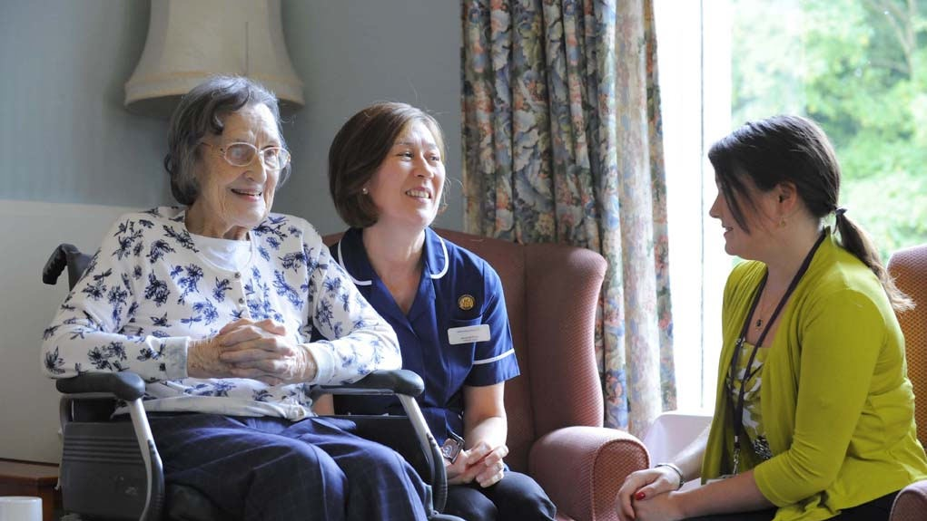
Population
diabetic type 2 patients
> 65 yo
Living at home
In Isère / Savoie / Haute Savoie (France)
Rural/semi rural/(urban) settings
Without demencia, or mental handicap
Sampling criteria:
  age, marital status, living area, antidiabetic treatments (per os, insulin),

Slide 5
Results – population
21 interviews
From September 2017 to March 2018
12 men and 9 women
From 66 to 92yo (mean: 76.1 men, 80.7 women)
Living area
  Rural 13 patients
  Semi rural 5 patients
  Urban 4 patients
Comorbidities
  Cardiovascular: HTA (n=7), stroke (n=2), myocardial infarction (n=1)
  Cancer (n=5)
Treatments
  None n=1
  Oral antidiabetic drugs n=20
  Insulins (associated with per os) n=3

Slide 6
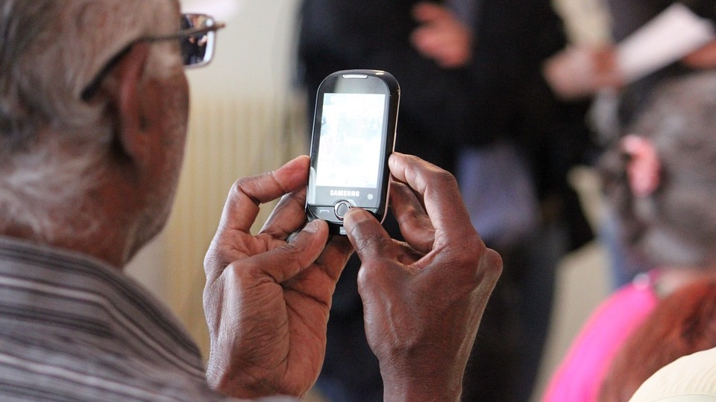
Resultats – themes
Help with hygiene and dietary measures
Daily practical management of their condition
Delivery on information about chronic conditions (e.g. diabetes)
Social needs (e.g. interaction between patients and the medical staff)

Slide 7

Limits
Study
ICT and elderly
Difficulty to imagine the device +++
Usefulness of IPA sometimes not felt
Therapeutic education issues
Lack of time, administrative burden, lack of funds, lack of training, communication….
Other solutions already existing
Integration with existing approaches
Short (first) interviews
Spousal influence in two-person interviews
In-surface analysis

Slide 8
Conclusion
3 main first functions:
  To support patient about lifestyle and dietetary measures
  Providing information concerning chronic conditions (e.g. diabetes)
  A reminder of medical and paramedical appointments
Co-construction with all stakeholders

