Slide 1

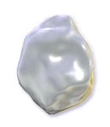
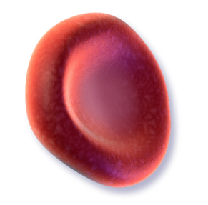
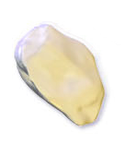

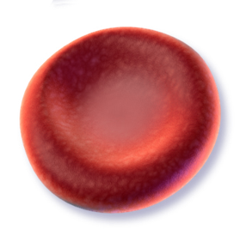
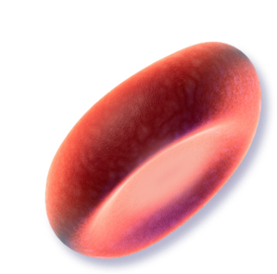

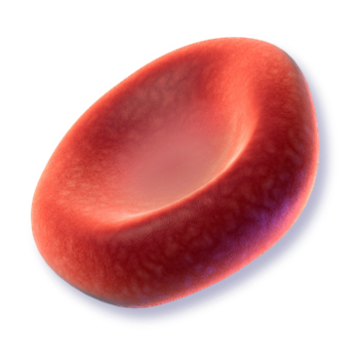
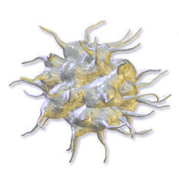
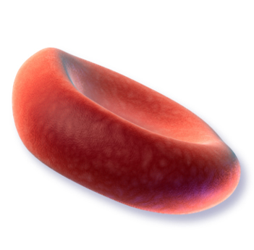
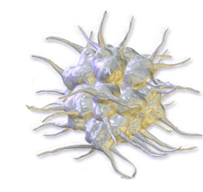
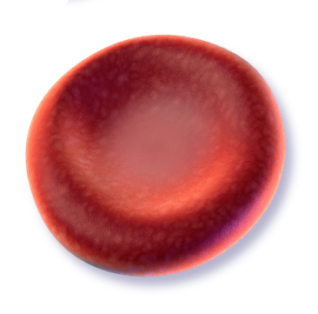
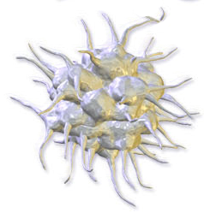
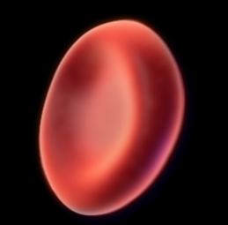
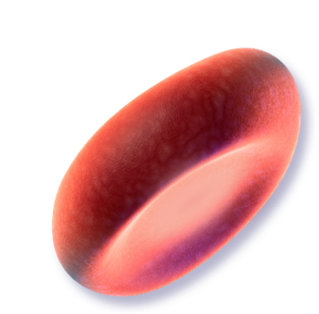






Anticoagulants safety in general practice: one year results from the CACAO multicenter prospective cohort study.
P. Frappé^{1,2,3}, J. Cogneau⁴, Y. Gaboreau^{5,6}, N. Abenhaïm⁴, M. Bayen⁷, C. Guichard⁴, J-P. Jacquet⁵, F. Lacoin⁴, S. Liébart⁸, L. Bertoletti^{2,9}, J-L. Bosson⁶ for the CACAO study investigators
1. Department of General Practice, University of Saint-Etienne, Saint-Etienne, France
2. Inserm UMR 1059 and CIC-EC 1408, University of Saint-Etienne, Saint-Etienne, France
3. Primary Care Unit, University of Geneva, Switzerland
4. Institut de Recherche en Médecine Générale, Paris, France
5. Department of General Practice, Grenoble Alpes University, Grenoble, France
6. TIMC-IMAG UMR 5525, Grenoble Alpes University, Grenoble, France
7. Department of General Practice, University of Lille, Lille, France
8. Ambulatory Care Consultation Unit, University Hospital of Saint-Etienne, Saint-Etienne, France
9. Department of Vascular Medicine and Therapeutics, University Hospital of Saint-Etienne, France
Aim
Real-world studies on anticoagulants are mostly based on health insurance databases or performed in secondary care.
 Our aim was to compare the occurrence of arterial or venous events, bleedings and deaths between vitamin K antagonist (VKA) and direct oral anticoagulants (DOAC) in a general practice setting
National prospective observational cohort
involving 444 general practitioners from January 1st to December 31, 2015
Methods
Participants were aged 18 years or more and have all a non-valvular atrial fibrillation or a thromboembolic indication for anticoagulant.
They were selected from the CACAO I study¹, which recruited them consecutively in primary care.
During the year of follow up, patients were followed as usual by their general practitioner, who collected every three months available data regarding the occurrence of :
 All events were adjudicated by an independent committee.
Incidence rates and Hazard Ratio were calculated with a Cox regression model. In arterial or venous events, as well as in bleeding events, we used Fine and Gray method to calculate absolute risk of events taking into account the competing risk of death. Since this study was observational, we used an adjustment method by propensity score.
- Arterial or venous events: deep vein thrombosis (DVT), pulmonary embolism (PE), transient ischemic attack (TIA), ischemic stroke, myocardial infarction, and arterial thrombosis of lower limb
- Bleeding
- Death
ClinicalTrials.gov protocol Identifier: NCT02376777
Table 1. Characteristics of patients and anticoagulation modalities, given the anticoagulant at the time of inclusion
Results
Characteristics |  | VKA | DOAC | P | Total
Patients, N (%) |  | 1 946 (100.0) | 1 136 (100.0) | - | 3 082 (100.0)
Age, mean (SD), y |  | 75.0 (11.5) | 73.3 (12.3) | < 0.001 | 74.4 (11.8)
Male, N (%) |  | 1 095 (56.3) | 594 (52.3) | 0.032 | 1 689 (54.8)
BMI >30, N (%), kg/m² |  | 576 (35.7) | 336 (34.9) | 0.680 | 912 (35.4)
Personal history, N (%)
 | Hypertension | 1 367 (70.3) | 757 (66.6) | 0.037 | 2 124 (68.9)
 | DVT and/or PE | 467 (24.0) | 186 (16.4) | < 0.001 | 653 (21.2)
 | Diabetes | 469 (24.1) | 253 (22.3) | 0.247 | 722 (23.4)
 | Coronary heart disease and/or MI | 393 (20.2) | 156 (13.7) | < 0.001 | 549 (17.8)
 | Symptomatic heart failure | 336 (17.3) | 141 (12.4) | < 0.001 | 477 (15.5)
 | Stroke and/or TIA | 303 (15.6) | 172 (15.1) | 0.750 | 475 (15.4)
 | Peripheral arterial disease | 220 (11.3) | 101 (8.9) | 0.034 | 321 (10.4)
 | Bleeding requiring hospitalization | 146 (7.5) | 54 (4.8) | 0.003 | 200 (6.5)
CHA₂DS₂-VASc ≥2 /Atrial fibrillation, n=2 611, N (%) |  | 1 499 (92.7) | 900 (90.5) | 0.050 | 2 399 (91.9)
HASBLED >3 / Atrial fibrillation, n=2 611, N (%) |  | 324 (20.0) | 111 (11.2) | < 0.001 | 435 (16.7)
Renal impairment (clearance <60 mL/min), N (%) |  | 533 (27.8) | 264 (23.2) | 0.016 | 797 (25.8)
Normal liver function (AST <3N, ALT <3N AND Bilirubin <2N), N (%) |  | 1 434 (73.7) | 875 (77.0) | 0.037 | 2 309 (74.9)
Indication for anticoagulation, N (%)
 | Non valvular atrial fibrillation | 1 619 (83.2) | 994 (87.5) | 0.001 | 2 613 (84.8)
 | Treatment of DVT/PE | 393 (20.2) | 159 (14.0) |  | 552 (17.9)
Timed up and go test as estimated by GP >30 sec, N (%) |  | 229 (11.8) | 108 (9.5) | 0.024 | 337 (10.9)
Duration of anticoagulation >1 year, N (%) |  | 1 446 (74.3) | 582 (51.3) | <0.001 | 2 028 (65.8)
Patient perceived by GP as not or not very adherent, N (%) |  | 103 (5.4) | 76 (6.8) | 0.102 | 179 (5.9)
At least one concomitant medication at risk of interaction*, N (%) |  | 1 148 (59.0) | 658 (57.9) | 0.561 | 1 806 (58.6)
Definitive stop of anticoagulation during the year, n=3 071, N (%) |  | 134 (6.9) | 135 (12.0) | <0.001 | 269 (8.8)
At least 1 temporary stop of anticoagulation, n=3 071, N (%) |  | 126 (6.5) | 67 (5.9) | 0.536 | 193 (6.3)
At least 1 change of anticoagulant class, n=3 071, N (%) |  | 43 (2.2) | 45 (4.0) | 0.005 | 88 (2.9)
3082 patients were included: 1946 patients (63.1%) had a VKA and 1136 patients (36.9%) had a DOAC.
11 patients (0.4%) were lost of follow-up during the year.
Survival analysis at one year (n=3038):
. 42 patients (1.7%) had an arterial or venous event
. 151 patients (6.1%) had a bleeding, including 47 (1.9%) major bleedings
. 105 patients (4.1%) patients died.
The propensity matching selected 1866 patients (area under ROC curve = 0.675):
. 935 patients (50.1%) had a VKA and 931 patients (49.9%) had a DOAC.
. 16 patients were lost of follow-up (0.9%).
Table 2. One-year outcomes in propensity-matched sample, given the anticoagulant class at the time of the outcome
One year outcomes, N (%) |  | VKA | DOAC | Total | HR [95%CI]
At least one arterial or venous event |  | 15 (1.9) | 14 (1.9) | 29 (1.9) | 1.00 [0.48-2.07]
Any bleeding |  | 38 (4.9) | 55 (7.4) | 93 (6.1) | 0.65 [0.43-0.98]
 | Major bleeding | 8 (1.0) | 17 (2.3) | 25 (1.6) | 0.45 [0.19-1.03]
 | Non major but clinically relevant bleeding | 21 (2.7) | 22 (2.9) | 43 (2.8) | 0.90 [0.50-1.64]
 | Minor bleeding | 9 (1.1) | 16 (2.1) | 25 (1.6) | 0.52 [0.23-1.18]
All-cause death |  | 40 (5.0) | 19 (2.5) | 59 (3.8) | 1.98 [1.15-3.42]
 | Bleeding cause | 2 (0.3) | 6 (0.8) | 8 (0.5)
VKA: vitamine-k antagonists, DOA: direct oral anticoagulants, BMI: body mass index, DVT: deep vein thrombosis, PE: pulmonary embolism, MI: myocardial infarction, TIA: transient ischemic attack, BID: twice daily, OD: once daily
*Collected concomitant medications were : statin, amiodarone, antiplatelet, serotonin reuptake inhibitors, fibrate, verapamil, NSAID, quinidine, carbamazepine, tacrolimus, ciclosporin, anticoagulant, systemic antifungal therapy, rifampicin, protease inhibitors
VKA, vitamine-k antagonists; DOAC, direct oral anticoagulants; HR, Hazard ratio taking into account the competitive risk with death.
There was no significant difference between VKA and DOAC groups regarding arterial or venous events and major bleedings.
VKA group had a lower incidence of overall bleedings and a two times higher incidence of deaths (HR=1.98, IC95% [1.15-3.42]), but this difference was not due to bleeding causes.
Those results are in line with data from the literature, except regarding overall bleedings, suggesting that
considering all patients’ profiles and all bleedings encountered in general practice
could moderate results measured in previous cohorts based on databases and/or performed in secondary care,
but does not question known safety data on DOAC and VKA.
Conclusion
Photo credit: hand worship by icon4yu from the Noun Project
Frappé P, Cogneau J, Gaboreau Y, Abenhaïm N, Bayen M, Calafiore M, Guichard C, Jacquet JP, Lacoin F, Bertoletti L; CACAO study investigators.
Areas of improvement in anticoagulant safety. Data from the CACAO study, a cohort in general practice. PLoS One. 2017:6;12(4):e0175167.
www.etudecacao.fr
contact@etudecacao.fr
The authors are indebted to Claire Eychenne, Carole Rolland, and Céline Vermorel for their assistance in data management and analysis. We thank the members of the Primary care unit of the University of Geneva (Switzerland) for their editorial advice.
We declare we have received payment from a third party for the submitted work: the CACAO study was supported by the French government (continuing professional development of investigators).

